Slide 1

HUATULCO RACE HISTORY
Elite Analysis · Past 8 Years · May 2026
USA Triathlon High Performance

Slide 2
Race Week Schedule
Huatulco
June 12 – 14, 2026 • Plaza Santa Cruz Huatulco, Mexico
Friday • June 12
Saturday • June 13
Sunday • June 14
Familiarization Day
Briefing & Packet Pickup
RACE DAY
10:00 | Bike familiarization — 3 laps from Bahía Santa Cruz
10:30 | Run familiarization
11:00 – 11:45 | Swim familiarization — Santa Cruz
16:00 – 16:30 | ★ Mandatory Elite athlete meeting — Hotel Biniguenda
16:30 – 17:00 | Packet pickup — Hotel Biniguenda
05:30 | Elite Female lounge opens
06:30 | ★ ELITE FEMALE START
07:45 | Elite Male lounge opens
08:30 | ★ ELITE MALE START
10:00 | Awards ceremony
Times local to Huatulco (CST, UTC-6). Schedule confirmed from World Triathlon race-info page; subject to organiser updates.

Slide 3
Key Course Differentiators
Huatulco
HUATULCO
COURSE AT A GLANCE
[PLACEHOLDER: 2-3 sentences on what makes Huatulco unique as a race venue — geography, setting, and character. E.g. 'Set on the Coral Riviera of Sardinia, the WTCS Alghero course combines crystal-clear Mediterranean waters, a flat coastal bike circuit, and a multi-lap run through the ancient walled city.']
Swim:
0.8 km
Bike:
20.0 km
Run:
5.0 km
Format:
Standard Triathlon
COURSE FEATURES
Bike Laps:
4
Run Laps:
2
• [PLACEHOLDER: Feature 1 — e.g. 'Open-water swim in the Bay of Huatulco — calm seas']
QUICK LINKS
• [PLACEHOLDER: Feature 2 — e.g. 'Flat coastal bike circuit — fast and tactical']
Current Race Info:
[PLACEHOLDER: https://www.triathlon.org/events/event/2026_world_triathlon_championship_series_huatulco]
• [PLACEHOLDER: Feature 3 — e.g. 'Multi-lap run through the historic city centre']
Last Year's Results:
https://www.triathlon.org/events/event/2025_world_triathlon_cup_huatulco
• [PLACEHOLDER: Feature 4 — e.g. 'Hot Mediterranean conditions typical in late May']
Race Replay:
[PLACEHOLDER: https://triathlonlive.tv/ (TriathlonLIVE replay)]

Slide 4
Course Profile & Map
Huatulco
[PLACEHOLDER: Insert upcoming course map or race photo here] Right-click → Replace Image, or paste screenshot of the World Triathlon course map PDF.
[PLACEHOLDER: Insert previous year course map or race photo here] Right-click → Replace Image, or paste screenshot of the World Triathlon course map PDF.
2026 Course
2025 Course
Source: [PLACEHOLDER: World Triathlon event page URL]
Source: https://www.triathlon.org/events/event/2025_world_triathlon_cup_huatulco
Discipline | Distance | Laps | Terrain / Notes
Swim | 0.8 km | — | [PLACEHOLDER: e.g. Open-water, Bay of Huatulco]
Bike | 20.0 km | 4 | [PLACEHOLDER: e.g. Flat coastal road circuit, closed course]
Run | 5.0 km | 2 | [PLACEHOLDER: e.g. Flat multi-lap, cobblestone city-centre finish]

Slide 5
Swim Course Profile
Huatulco
750 m • single lap
Ocean — Bahía de Santa Cruz (protected marina)
Distance
Layout
Start
750 m
U-shape rectangle
Beach start (running entry)
[Drop swim course map here] Save the organiser map as: ppt files/support/huatulco_swim_course.png It will be embedded automatically on the next run.
Water Temp
Wetsuit
Lap Count
30.5 °C (7-yr avg)
Non-wetsuit (water > 22 °C)
1
Tactical Notes
• Single 750 m loop — 300 m east leg, 150 m across south, 300 m west leg, beach exit by transition
• Tight rectangle inside the protected marina — minimal chop, current normally low at 06:30 start
• Two turn buoys at the south end — Chief Swim films from outside; angled kayak inside prevents course-cutting
• Sun rising due east at 06:30 — bright glare on the outbound 300 m east leg
Source: asdeporte 2026 Elite Swim course map (Natación Elite — Bahía de Santa Cruz)
• Extraction zone marked at north dock; short beach run into T1

Slide 6
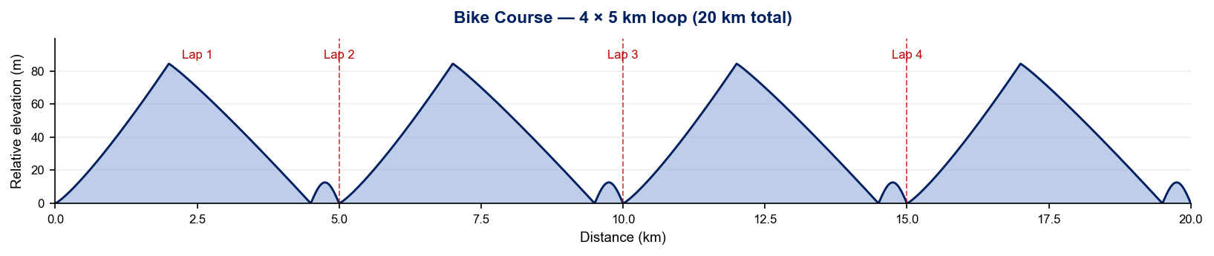
Bike Course Profile
Huatulco
20 km • 4 × 5 km loops
Closed urban circuit (Bahía de Santa Cruz → Vialidad 5 → return)
[Drop course map here] Save the organiser course map as: ppt files/support/huatulco_bike_course.png It will be embedded automatically on the next run.
Elevation / Lap
Total Climb
Avg Grade
+84.4 m / 84.6 m
~338 m
3.2%
Max Climb Grade
Max Descent
Loops
+18.4%
-14.9%
4 × 5 km
Tactical Implications
• Out-and-back along Blvd Santa Cruz with a tight technical hairpin at the neutral wheel station
Source: asdeporte 2026 Elite Cycling course map
• Single sustained climb up Vialidad 5 — short but punchy (max 18.4%); strong riders can split the field every lap
• Fast technical descent back into Bahía de Santa Cruz; max -14.9% grade rewards confident bike-handling
• Tight start/finish chicane through transition — drafting packs reshuffle every lap on the climb and descent
Stylised — exact contours from a GPS-recorded race FIT would refine this.

Slide 7
Run Course Profile
Huatulco
5.0 km • 2 × 2.5 km
Paved urban — Blvd Santa Cruz / Camino a Santa Cruz
Distance
Lap Structure
Total Climb
5.0 km
2 × 2.5 km
~111 m
[Drop run course map here] Save the organiser map as: ppt files/support/huatulco_run_course.png It will be embedded automatically on the next run.
Avg Grade
Max ▲ / ▼
Heat Risk
4.2%
+17.3% / -15.3%
HIGH
Tactical Notes
• Hilly 2.5 km out-and-back loop — +55.3 m gain per lap (≈110 m total over 5 km)
• Max climb 17.3% on Camino a Santa Cruz — short steep pinch that bites harder on lap 2
• Steep -15.3% descent back into Bahía de Santa Cruz — light braking + high cadence preserves the legs
• 08:30 men's start runs into peak surface temps with limited shade on the climb
Source: asdeporte 2026 Elite Run course map (Carrera Elite — Boulevard Santa Cruz)
• Aid stations at 1 km and 2 km plus start/finish; penalty box at start/finish — drafting tickets compound across both laps
• Course turnaround at the 2 km mark off Blvd Chahue — sharp 180° on a slight uphill

Slide 8
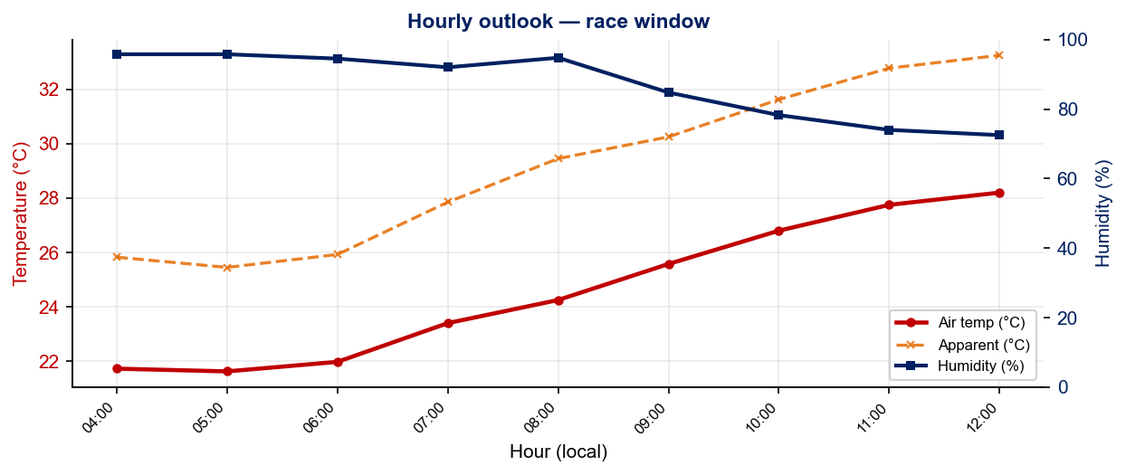
Race-Day Weather Outlook
Huatulco
2026-06-14 • Historical climatology — same calendar day, 7-year mean
Female start — 06:30
Temperature
Apparent / Heat
Humidity
23.2 °C
27.7 °C
94%
Wind
UV peak
Heat Stress
3.2 km/h
—
MODERATE
Male start — 08:30
Temperature
Apparent / Heat
Humidity
25.5 °C
30.4 °C
86%
Wind
UV peak
Heat Stress
3.9 km/h
—
HIGH
Hydration & Cooling Cues
• Standard heat protocol — pre-cool 10 min, sponges/ice at every aid station, target 600–800 ml/h on bike
• Men's race runs 2.3 °C hotter than women's — heat-acclim work + heavier cooling kit for the 08:30 start
Data source: Open-Meteo. Forecast will replace climatology once race day is within 16 days. Historical Race Conditions slide shows what actually happened in prior years.

Slide 9
Environmental Risk Profile
Huatulco
RACE-DAY WEATHER (08:00–11:00 local)
AIR QUALITY (Open-Meteo archive)
Year | Date | Air Temp | Humidity | Wind km/h | Precip mm
2018 | Jun 10 | 29.2 | 72% | 10 | 0.0
2019 | Jun 08 | 28.3 | 77% | 4 | 0.1
2021 | Jun 12 | 26.8 | 82% | 16 | 0.0
2022 | Jun 18 | 28 | 68% | 6 | 0.0
2023 | Jun 17 | 32.8 | 60% | 7 | 0.1
2024 | May 18 | 29.3 | 62% | 7 | 0.0
2025 | Jun 22 | 24 | 96% | 4 | 2.6
Year | PM2.5 | EU AQI | UV Index | Risk
2018 | — | — | — | —
2019 | — | — | — | —
2021 | — | — | — | —
2022 | — | — | — | —
2023 | 7.7 | 21 | 5.3 | Fair
2024 | 4.3 | 20 | 4.3 | Good
2025 | 3.4 | 16 | 4.5 | Good
HEALTH & WATER QUALITY RISK FACTORS
• Water Quality: [PLACEHOLDER: Historical water quality data for Huatulco — e.g. bacterial counts, EU Bathing Water Directive status, known algae / pollution events. Check local environmental agency reports for May race window.]
• Athlete Health Incidents: [PLACEHOLDER: Any known GI illness, respiratory, or heat-related incidents at this or comparable venues. E.g. Sunderland 2023 — reported GI illness post-swim for multiple athletes.]
• Water Temperature: [PLACEHOLDER: Historical open-water temperature for Huatulco in May (not available from Open-Meteo; check Copernicus Marine / NOAA or WT historical results).]
• Heat / Humidity Risk: Auto-derived from above table — flag if humidity >70% or air temp >25°C at race time.
Weather and AQ data: Open-Meteo historical archive (archive-api.open-meteo.com). EU AQI: Good ≤20, Fair ≤40, Moderate ≤60, Poor ≤80, Very Poor >80.

Slide 10
Who to Watch — Huatulco Race Week
ELITE MEN
ELITE WOMEN
Top 3 Ranked on Startlist
Top 3 Ranked on Startlist
Rank | Athlete | Points
15 | Tyler Mislawchuk | 2,943
42 | Aoba Yasumatsu | 2,080
52 | Liam Donnelly | 1,939
Rank | Athlete | Points
24 | Maria Carolina Velasquez Soto | 2,558
25 | Rosa Maria Tapia Vidal | 2,515
49 | Danielle Orie | 1,941
Returning Podium Athletes on Startlist
Returning Podium Athletes on Startlist
2. Alejandro Rodriguez Diez (00:55:07)
1. Maria Carolina Velasquez Soto (01:00:08)
3. Kuba Gajda (00:55:11)
3. Elizabeth Bravo (01:00:09)
Rankings = current World Triathlon rankings snapshot; startlist intersect uses program_entries when available.

Slide 11
ELITE MEN

Slide 12
Race Overview — Elite Men
Huatulco
RACE HISTORY AT HUATULCO
3 KEYS TO SUCCESS
The Elite Men race at Huatulco has been held 7 times in this analysis window (2018–2025). Tyler Mislawchuk is the most successful athlete in this span with 2 victories. The event is staged as part of the World Cup calendar. [PLACEHOLDER: Add 1–2 sentences on notable storylines, competitive history, or what makes this event significant for Elite Men athletes. E.g. defending champions, record performances, dramatic finishes.]
1
Swim positioning matters — an average of 20 athletes exit the water within 15 sec of the leader. Entering the bike in the front pack is critical; conserve energy with a disciplined swim line rather than sprinting alone.
2
[PLACEHOLDER: Key 2 — Describe bike strategy: is this a pack race or do breakaways form? What power/tactics are needed to stay in the lead group?]
3
Run speed separates the podium — the fastest run pace averages ~1:30/km with a ~103s spread between fastest and average finisher. Either a pre-built lead from the bike or exceptional run speed is required to win.

Slide 13
Results Summary — Elite Men
Huatulco
Year | Date | Category | Field | DNF/LAP/DNS | Winner | Winner Time | Air Temp | Water Temp | Swim km | Bike km | Run km
2018 | Jun 10 | World Cup | 66 | 6 | Lopez | 55:32 | 29.2 | — | — | — | —
2019 | Jun 08 | World Cup | 62 | 7 | Mislawchuk | 55:04 | 28.3 | — | — | — | —
2021 | Jun 12 | World Cup | 60 | 11 | Mislawchuk | 53:09 | 26.8 | — | — | — | —
2022 | Jun 18 | World Cup * | 65 | 8 | Grau | 53:47 | 28 | 29 | 0.75 | 20.0 | 5.0
2023 | Jun 17 | World Cup | 64 | 6 | Fajardo | 54:13 | 32.8 | 31.7 | 0.75 | 20.0 | 5.0
2024 | May 18 | World Cup * | 52 | 7 | Murray | 58:07 | 29.3 | 30 | 0.75 | 22.2 | 5.0
2025 | Jun 22 | World Cup * | 49 | 4 | Sagiv | 54:53 | 24 | 29 | 0.75 | 20.0 | 5.0
* Course distance changed vs. prior year

Slide 14
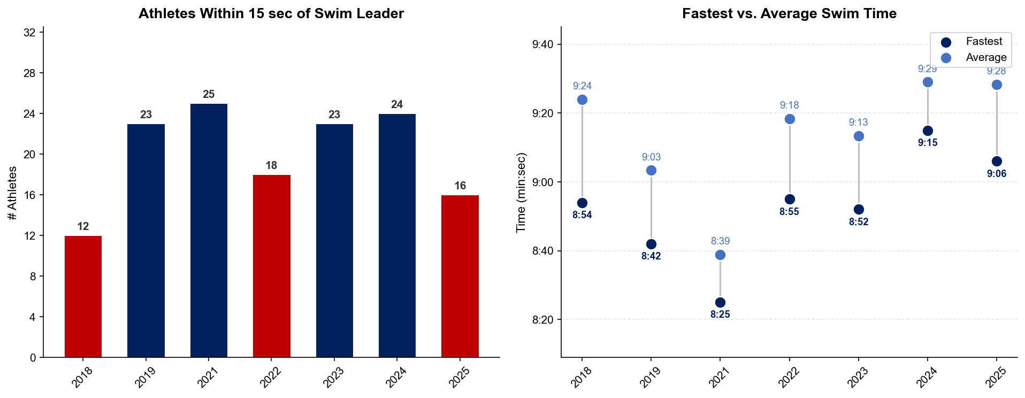
Swim Exit Dynamics — Elite Men
Huatulco

Slide 15
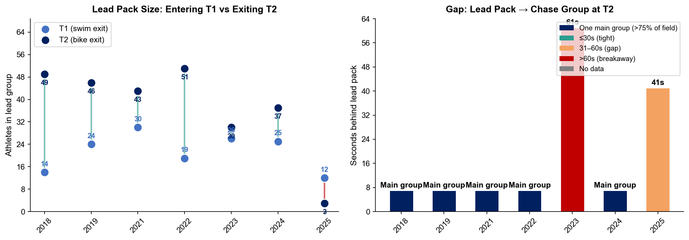
Bike Pack Evolution — Elite Men
Huatulco
Lead pack = athletes within 15 sec of leader. T1 = lead group entering the bike; T2 = lead group exiting the bike.
Year | Lead Size @ T1 | Lead Size @ T2 | Change | Chase Group @ T2 | Chase Gap*
2018 | 14 | 49 | +35 | 1 | 42s
2019 | 24 | 46 | +22 | 7 | 88s
2021 | 30 | 43 | +13 | 1 | 187s
2022 | 19 | 51 | +32 | 1 | 103s
2023 | 26 | 30 | +4 | 22 | 61s
2024 | 25 | 37 | +12 | 1 | 237s
2025 | 12 | 3 | -9 | 31 | 41s
Lead pack = athletes within 15 sec of leader. Chase group = athletes within 15 sec of the first athlete outside the lead pack. * Chase Gap = seconds from the last lead-pack athlete to the first chase-group athlete at T2.
Dropouts: 2018: 4 DNF/LAP (1 in lead group at bike) | 2019: 6 DNF/LAP (2 in lead group at bike, t1) | 2021: 8 DNF/LAP (2 in lead group at bike) | 2022: 5 DNF/LAP (2 in lead group at bike, t1) | 2023: 6 DNF/LAP | 2024: 5 DNF/LAP (2 in lead group at bike, t1) | 2025: 3 DNF/LAP

Slide 16
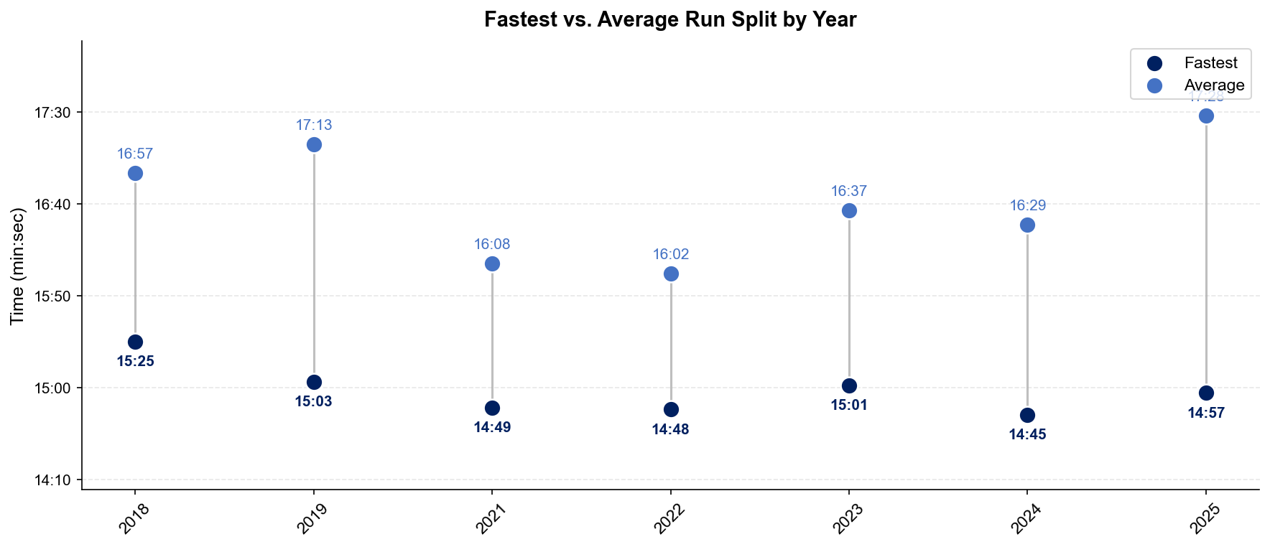
Run Split Analysis — Elite Men
Huatulco

Slide 17
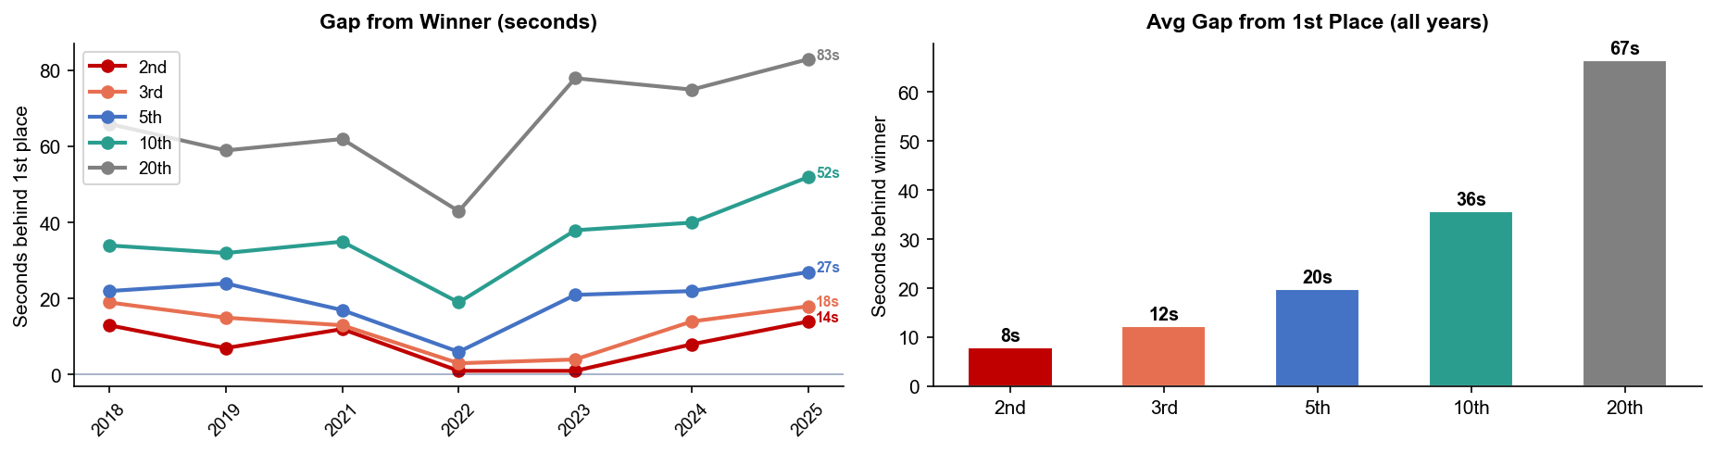
Key Position Times — Elite Men
Huatulco
Year | 1st | 2nd | 3rd | 5th | 10th | 20th
2018 | 55:32 | 55:45 +13s | 55:51 +19s | 55:54 +22s | 56:06 +34s | 56:38 +66s
2019 | 55:04 | 55:11 +7s | 55:19 +15s | 55:28 +24s | 55:36 +32s | 56:03 +59s
2021 | 53:09 | 53:21 +12s | 53:22 +13s | 53:26 +17s | 53:44 +35s | 54:11 +62s
2022 | 53:47 | 53:48 +1s | 53:50 +3s | 53:53 +6s | 54:06 +19s | 54:30 +43s
2023 | 54:13 | 54:14 +1s | 54:17 +4s | 54:34 +21s | 54:51 +38s | 55:31 +78s
2024 | 58:07 | 58:15 +8s | 58:21 +14s | 58:29 +22s | 58:47 +40s | 59:22 +75s
2025 | 54:53 | 55:07 +14s | 55:11 +18s | 55:20 +27s | 55:45 +52s | 56:16 +83s

Slide 18
Race Conditions — Elite Men
Huatulco
Year | Date | Air Temp | Humidity | Wind (km/h) | Precip (mm) | Water Temp | Wetsuit | Conditions
2018 | Jun 10 | 29.2 | 72% | 10 | 0.0 | — | — | —
2019 | Jun 08 | 28.3 | 77% | 4 | 0.1 | — | — | —
2021 | Jun 12 | 26.8 | 82% | 16 | 0.0 | — | — | —
2022 | Jun 18 | 28 | 68% | 6 | 0.0 | 29 | forbidden | —
2023 | Jun 17 | 32.8 | 60% | 7 | 0.1 | 31.7 | — | —
2024 | May 18 | 29.3 | 62% | 7 | 0.0 | 30 | forbidden | —
2025 | Jun 22 | 24 | 96% | 4 | 2.6 | 29 | forbidden | —
Air temp, humidity, wind, and precipitation sourced from Open-Meteo historical archive (race window 08:00–11:00 local) where WT API data is absent. Values marked * are Open-Meteo estimates. Water temp and wetsuit ruling are from the World Triathlon API per program.

Slide 19
ELITE WOMEN

Slide 20
Race Overview — Elite Women
Huatulco
RACE HISTORY AT HUATULCO
3 KEYS TO SUCCESS
The Elite Women race at Huatulco has been held 7 times in this analysis window (2018–2025). Alberte Kjær Pedersen is the most successful athlete in this span with 2 victories. The event is staged as part of the World Cup calendar. [PLACEHOLDER: Add 1–2 sentences on notable storylines, competitive history, or what makes this event significant for Elite Women athletes. E.g. defending champions, record performances, dramatic finishes.]
1
Fast swimming is decisive — only ~10 athletes typically leave the water together. A strong swim directly builds a race-winning gap before T1.
2
[PLACEHOLDER: Key 2 — Describe bike strategy: is this a pack race or do breakaways form? What power/tactics are needed to stay in the lead group?]
3
Run speed separates the podium — the fastest run pace averages ~1:41/km with a ~124s spread between fastest and average finisher. Either a pre-built lead from the bike or exceptional run speed is required to win.

Slide 21
Results Summary — Elite Women
Huatulco
Year | Date | Category | Field | DNF/LAP/DNS | Winner | Winner Time | Air Temp | Water Temp | Swim km | Bike km | Run km
2018 | Jun 10 | World Cup | 41 | 3 | Sodaro | 1:01:14 | 29.2 | — | — | — | —
2019 | Jun 08 | World Cup | 42 | 4 | Rappaport | 1:00:56 | 28.3 | — | — | — | —
2021 | Jun 12 | World Cup | 43 | 5 | Pedersen | 1:00:24 | 26.8 | — | — | — | —
2022 | Jun 18 | World Cup * | 56 | 4 | Koch | 1:00:01 | 29 | 31 | 0.75 | 20.0 | 5.0
2023 | Jun 17 | World Cup | 61 | 7 | Corral | 1:00:31 | 35 | 31.8 | 0.75 | 20.0 | 5.0
2024 | May 18 | World Cup * | 45 | 10 | Pedersen | 1:04:54 | 33.9 | 30 | 0.75 | 22.2 | 5.0
2025 | Jun 22 | World Cup * | 35 | 3 | Soto | 1:00:08 | 24 | 29 | 0.75 | 20.0 | 5.0
* Course distance changed vs. prior year

Slide 22
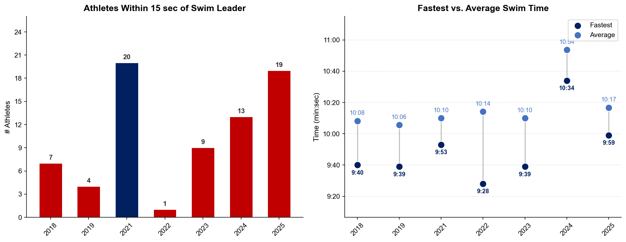
Swim Exit Dynamics — Elite Women
Huatulco

Slide 23
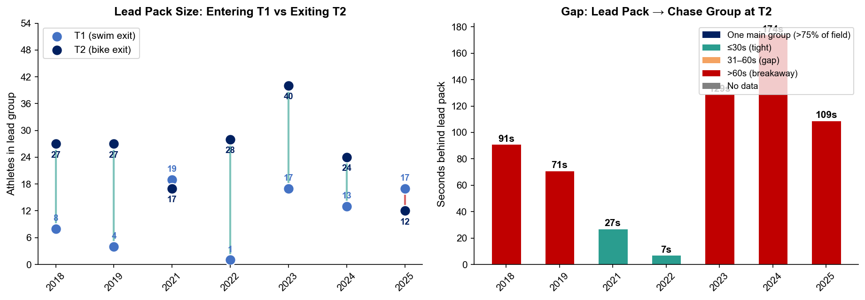
Bike Pack Evolution — Elite Women
Huatulco
Lead pack = athletes within 15 sec of leader. T1 = lead group entering the bike; T2 = lead group exiting the bike.
Year | Lead Size @ T1 | Lead Size @ T2 | Change | Chase Group @ T2 | Chase Gap*
2018 | 8 | 27 | +19 | 5 | 91s
2019 | 4 | 27 | +23 | 7 | 71s
2021 | 19 | 17 | -2 | 1 | 27s
2022 | 1 | 28 | +27 | 1 | 7s
2023 | 17 | 40 | +23 | 1 | 129s
2024 | 13 | 24 | +11 | 5 | 174s
2025 | 17 | 12 | -5 | 14 | 109s
Lead pack = athletes within 15 sec of leader. Chase group = athletes within 15 sec of the first athlete outside the lead pack. * Chase Gap = seconds from the last lead-pack athlete to the first chase-group athlete at T2.
Dropouts: 2018: 3 DNF/LAP (1 in lead group at bike) | 2019: 3 DNF/LAP | 2021: 3 DNF/LAP | 2022: 3 DNF/LAP | 2023: 6 DNF/LAP (3 in lead group at bike, t1) | 2024: 6 DNF/LAP (2 in lead group at bike, t1) | 2025: 2 DNF/LAP (1 in lead group at t1)

Slide 24
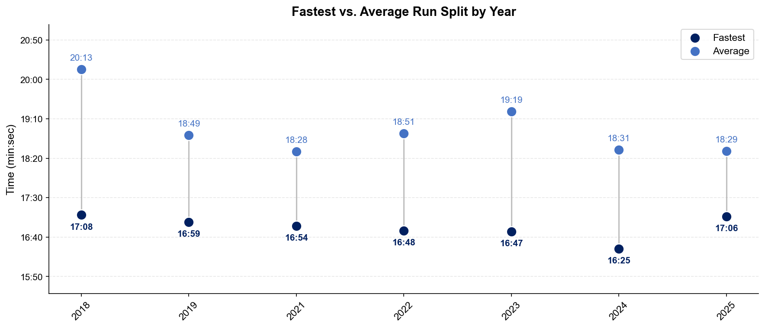
Run Split Analysis — Elite Women
Huatulco

Slide 25
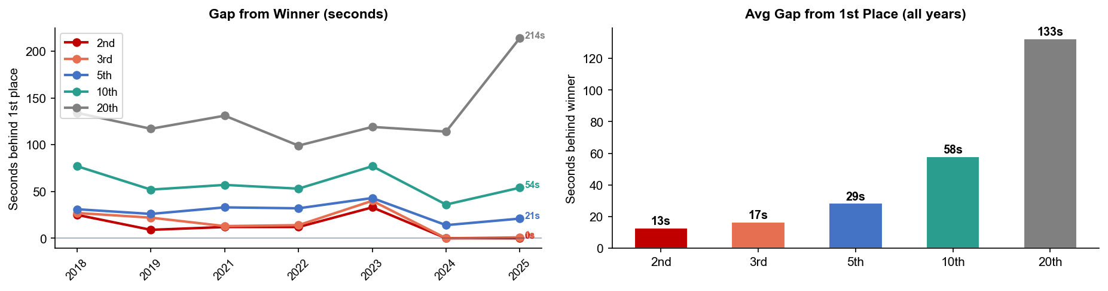
Key Position Times — Elite Women
Huatulco
Year | 1st | 2nd | 3rd | 5th | 10th | 20th
2018 | 1:01:14 | 1:01:39 +25s | 1:01:41 +27s | 1:01:45 +31s | 1:02:31 +77s | 1:03:28 +134s
2019 | 1:00:56 | 1:01:05 +9s | 1:01:18 +22s | 1:01:22 +26s | 1:01:48 +52s | 1:02:53 +117s
2021 | 1:00:24 | 1:00:36 +12s | 1:00:37 +13s | 1:00:57 +33s | 1:01:21 +57s | 1:02:35 +131s
2022 | 1:00:01 | 1:00:13 +12s | 1:00:15 +14s | 1:00:33 +32s | 1:00:54 +53s | 1:01:40 +99s
2023 | 1:00:31 | 1:01:04 +33s | 1:01:11 +40s | 1:01:14 +43s | 1:01:48 +77s | 1:02:30 +119s
2024 | 1:04:54 | 1:04:54 | 1:04:54 | 1:05:08 +14s | 1:05:30 +36s | 1:06:48 +114s
2025 | 1:00:08 | 1:00:08 | 1:00:09 +1s | 1:00:29 +21s | 1:01:02 +54s | 1:03:42 +214s

Slide 26
Race Conditions — Elite Women
Huatulco
Year | Date | Air Temp | Humidity | Wind (km/h) | Precip (mm) | Water Temp | Wetsuit | Conditions
2018 | Jun 10 | 29.2 | 72% | 10 | 0.0 | — | — | —
2019 | Jun 08 | 28.3 | 77% | 4 | 0.1 | — | — | —
2021 | Jun 12 | 26.8 | 82% | 16 | 0.0 | — | — | —
2022 | Jun 18 | 29 | 68% | 6 | 0.0 | 31 | forbidden | —
2023 | Jun 17 | 35 | 60% | 7 | 0.1 | 31.8 | forbidden | —
2024 | May 18 | 33.9 | 62% | 7 | 0.0 | 30 | forbidden | —
2025 | Jun 22 | 24 | 96% | 4 | 2.6 | 29 | forbidden | —
Air temp, humidity, wind, and precipitation sourced from Open-Meteo historical archive (race window 08:00–11:00 local) where WT API data is absent. Values marked * are Open-Meteo estimates. Water temp and wetsuit ruling are from the World Triathlon API per program.

